Slide 1
INTRODUCTION HISTORY FUNCTIONS MODULES OF PYTHON Presentation by Sucharitha

Slide 2
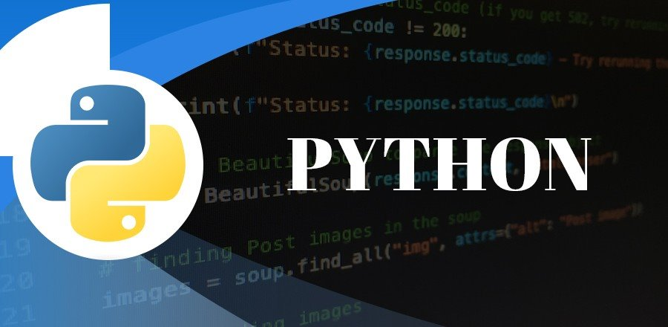

CONTENTS
Introduction
Features
History
Functions
Modules

Slide 3
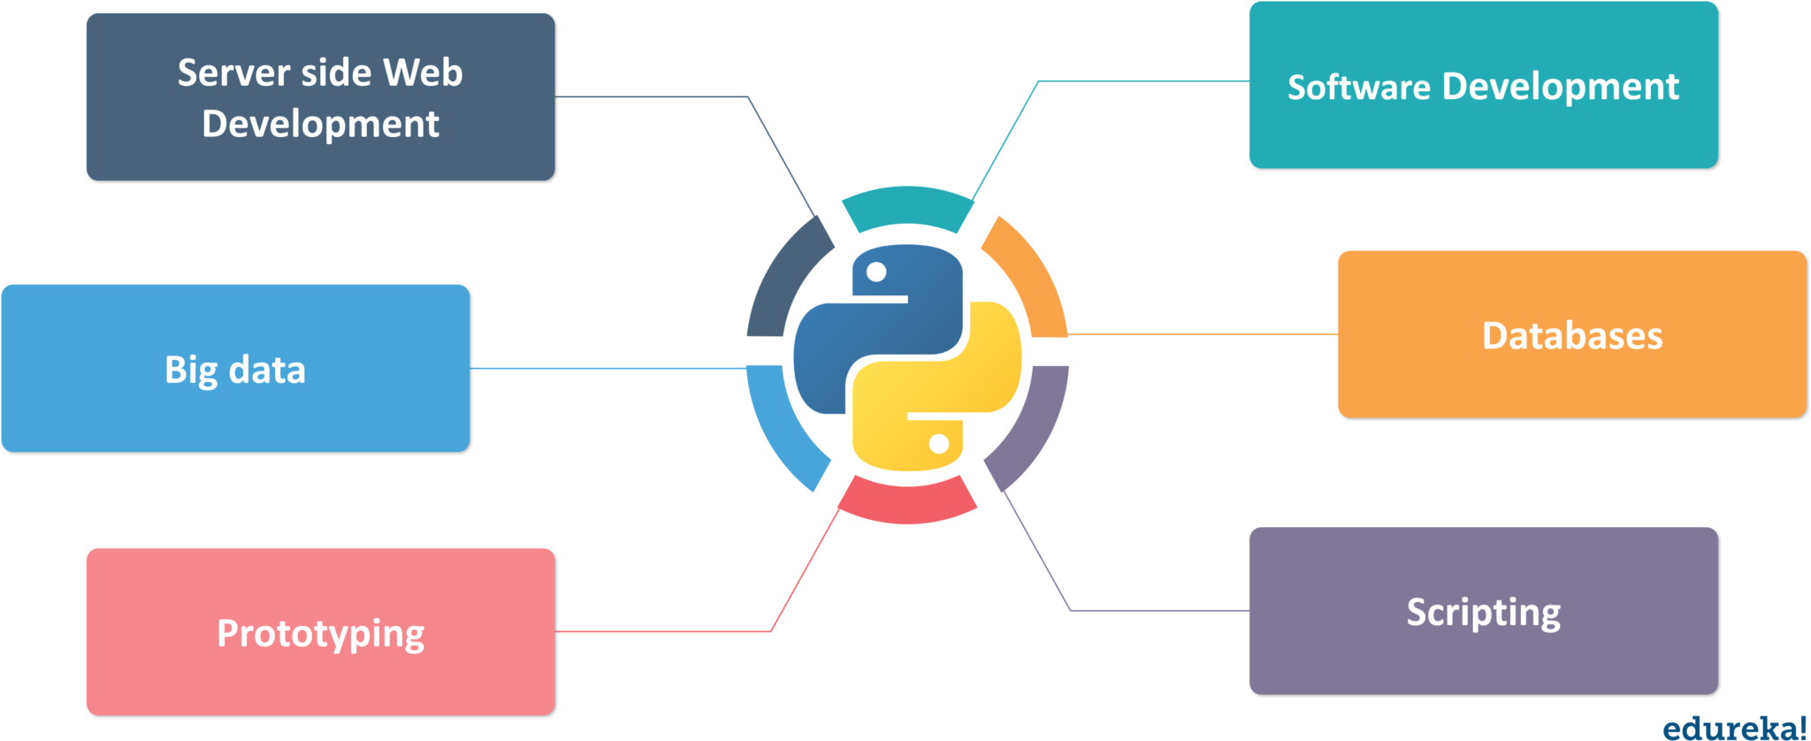
Introduction Python is a general-purpose, dynamically typed, high-level, compiled and interpreted, garbage-collected, and purely object-oriented programming language that supports procedural, object-oriented, and functional programming.

Slide 4
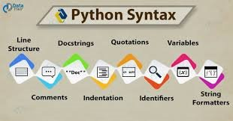
Python Basic Syntax
There is no use of curly braces or semicolons in Python programming language. It is an English-like language. But Python uses indentation to define a block of code. Indentation is nothing but adding whitespace before the statement when it is needed.
def func():
statement 1
statement 2
…………………
…………………
statement N

Slide 5
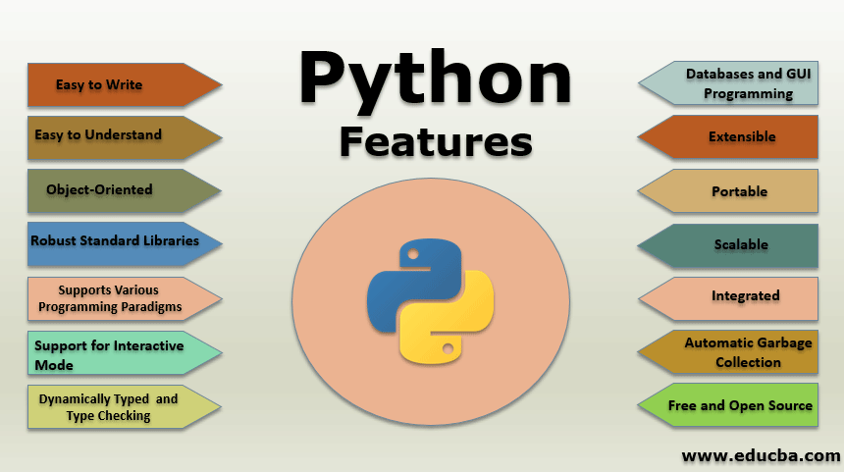
Features
Let's highlight some of the important features of Python that make it widely popular. Apart from these features where are number of other interesting features which make Python most of the developer's first choice.

Slide 6
Easy to learn
This is one of the most important reasons for the popularity of Python. Python has a limited set of keywords. Its features such as simple syntax, usage of indentation to avoid clutter of curly brackets and dynamic typing that doesn't necessitate prior declaration of variable help a beginner to learn Python quickly and easily.
Interpreter Based
Instructions in any programming languages must be translated into machine code for the processor to execute them. Programming languages are either compiler based or interpreter based.

Slide 7
Interactive
Standard Python distribution comes with an interactive shell that works on the principle of REPL (Read – Evaluate – Print – Loop). The shell presents a Python prompt >>>. You can type any valid Python expression and press Enter.
MultiParadigm
Python is a completely object-oriented language. Everything in a Python program is an object. However, Python conveniently encapsulates its object orientation to be used as an imperative or procedural language – such as C.

Slide 8
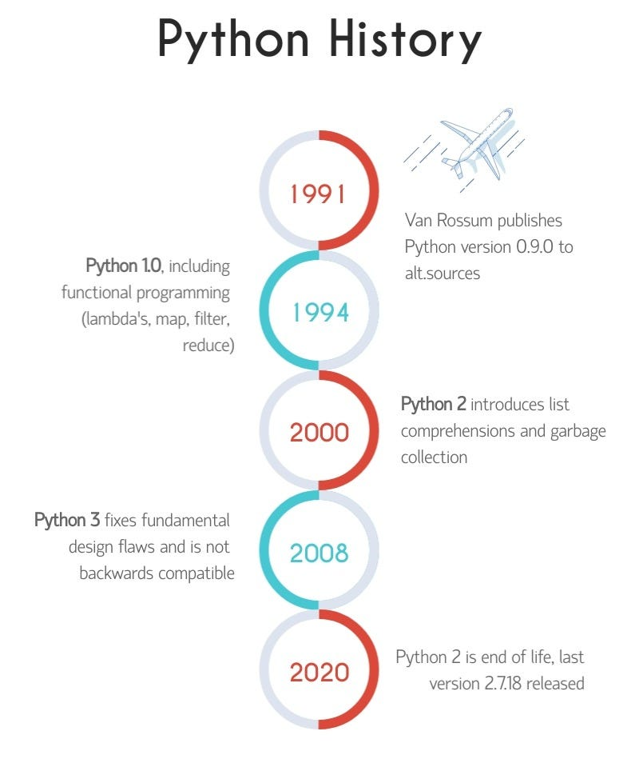
History of Python
Python is a widely used general-purpose, high-level programming language. It was initially designed by Guido van Rossum in 1991 and developed by Python Software Foundation. It was mainly developed for emphasis on code readability, and its syntax allows programmers to express concepts in fewer lines of code.
Who invented Python?
In the late 1980s, history was about to be written. It was that time when working on Python started. Soon after that, Guido Van Rossum began doing its application-based work in December of 1989 at Centrum Wiskunde & Informatica (CWI) which is situated in the Netherlands

Slide 9
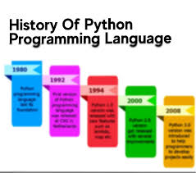
Evolution of Python
The language was finally released in 1991. When it was released, it used a lot fewer codes to express the concepts, when we compare it with Java, C++ & C. Its design philosophy was quite good too. Its main objective is to provide code readability and advanced developer productivity.

Slide 10
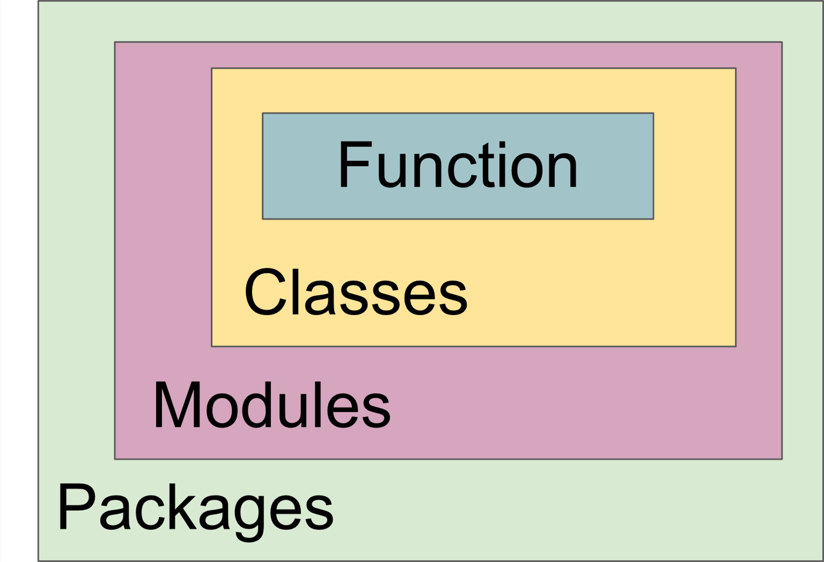
Python Functions
Python Functions is a block of statements that return the specific task. The idea is to put some commonly or repeatedly done tasks together and make a function so that instead of writing the same code again and again for different inputs, we can do the function calls to reuse code contained in it over and over again.

Slide 11
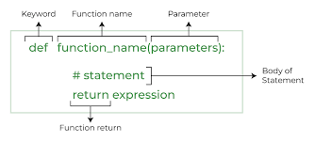
Python Function Declaration
THE SYNTAX TO DECLARE A FUNCTION IS:

Slide 12
Types of Functions in Python
Built-in library function:
These are Standard functions in Python that are available to use.
User-defined function:
We can create our own functions based on our requirements.

Slide 13
Calling a Function in Python
After creating a function in Python we can call it by using the name of the functions Python followed by parenthesis containing parameters of that particular function. Below is the example for calling def function Python.
# A simple Python function def fun(): print("Welcome to GFG") # Driver code to call a function fun()

Slide 14
Python Modules
What is Python Module
A Python module is a file containing Python definitions and statements. A module can define functions, classes, and variables. A module can also include runnable code.
Create a Python Module
To create a Python module, write the desired code and save that in a file with .py extension.

Slide 15
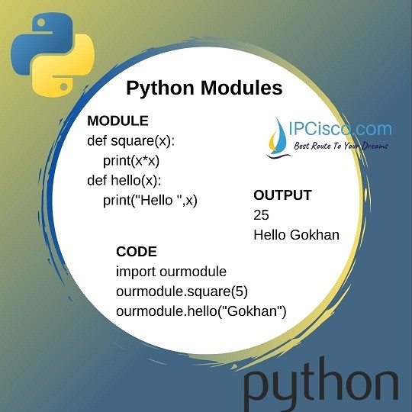
Import module in Python
We can import the functions, and classes defined in a module to another module using the import statement in some other Python source file.
When the interpreter encounters an import statement, it imports the module if the module is present in the search path.
Syntax
# importing module calc.py
import calc
print(calc.add(10, 2))

Slide 16
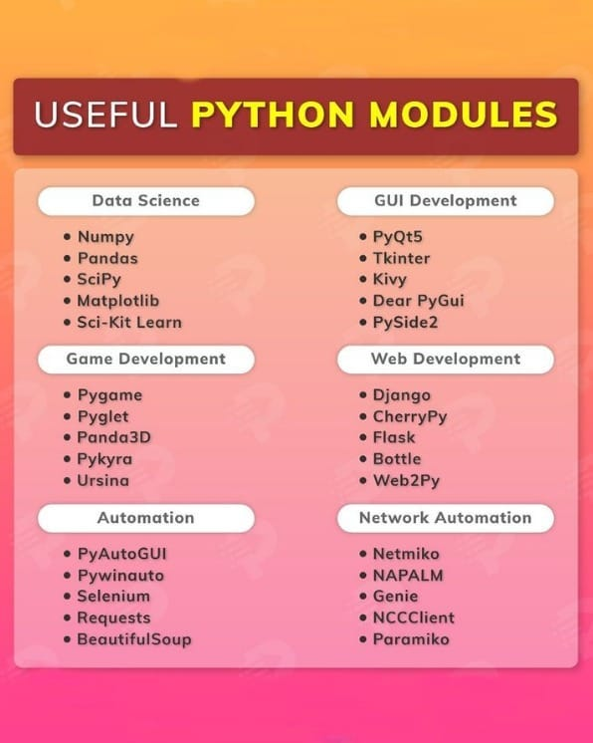
Import Specific Attributes from a Python module
# importing sqrt() and factorial from the
# module math
from math import sqrt, factorial
# if we simply do "import math", then
# math.sqrt(16) and math.factorial()
# are required.
print(sqrt(16))
print(factorial(6))

Slide 17
THANK
YOU

